Slide 1
Bohr’s model of the hydrogen atom:
Bohr combined classical and quantum concepts and gave his theory in the form of three postulates :
1. An electron in an atom could revolve in certain stable orbits without the emission of radiant energy. Hence, these orbits are also called “stationary orbits”.

Slide 2
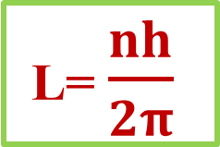
Bohr’s model of the hydrogen atom:
Bohr combined classical and quantum concepts and gave his theory in the form of three postulates :
2. Electron revolves around the nucleus only in those orbits for which the angular momentum (L) is some integral multiple of h/2π, where h is the Planck's constant.
L= $\frac{nh}{2π}$
i.e.,
where
n = 1,2,3,....
n = principal quantum number.

Slide 3
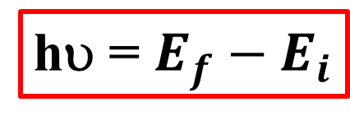
Bohr’s model of the hydrogen atom
Bohr combined classical and quantum concepts and gave his theory in the form of three postulates :
3. An electron might make a transition from one of its specified non radiating orbits to another of lower energy. When it does so, a photon is emitted having energy equal to the energy difference between the initial and final states.
hυ = $E_{f}−E_{i}$

Slide 4
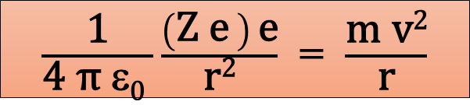
Radius of orbit (r):
For an electron revolving around a stationary nucleus the electrostatic force of attraction provides the necessary centripetal force . That is
i.e.,
$\frac{\text{1}}{\text{4 }\text{π} \text{ε}\text{0} }\frac{\left(\text{Z} \text{e} \right) \text{e}}{\text{r}\text{2}}$ = $\frac{\text{m} \text{v}\text{2}}{\text{r}}$

Slide 5
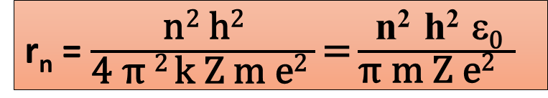

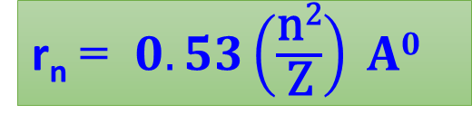
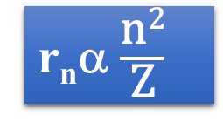
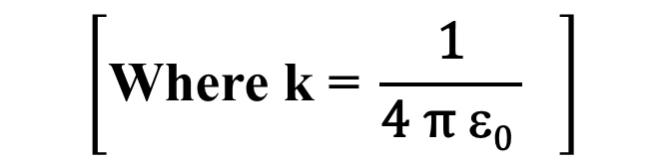
Also L = mvr = $\frac{\text{n} \text{h}}{\text{2 }\text{π}}$
From the above equations, radius of the n^{th} orbit is given by
r_{n} = $\frac{\text{n}\text{2} \text{h}\text{2}}{\text{4 }\text{π} \text{2 }\text{k} \text{Z} \text{m} \text{e}\text{2} }\text{=}\frac{ \text{n}\text{2 }\text{h}\text{2} \text{ε}\text{0 }}{\text{π} \text{m} \text{Z} \text{e}\text{2} }$
$$\left[\text{Where} \text{k}\text{ =} \frac{\text{1}}{\text{4 }\text{π} \text{ε}\text{0} } \right]$$
r_{n} = $0.53\left(\frac{\text{n}\text{2}}{\text{Z}}\right) A0$
r_{n}α $\frac{\text{n}\text{2}}{\text{Z}}$
The radius of the innermost orbit (n=1) of the hydrogen atom (z=1) is called Bohr’s radius r₀ i.e., 0.53 A⁰

Slide 6
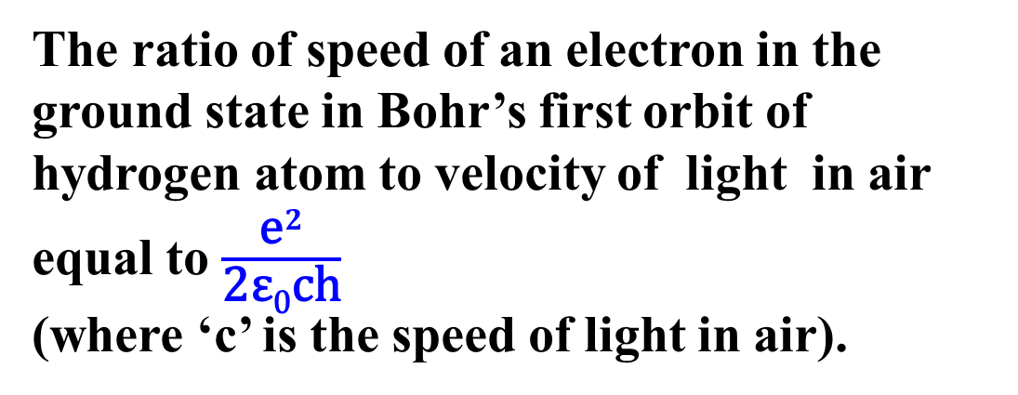
Speed of electron:
From the above relations, speed of electron in n^{th} orbit can be calculated as
V_{n} = $\frac{\text{2}\text{π}\text{kZ}{\text{e}}^{2}}{\text{nh}}\text{= }\frac{\text{Z}{\text{e}}^{2}}{\text{2}\text{ε}\text{0}\text{n}\text{h}}\text{= }\left(\frac{\text{c}}{\text{137}}\right) \frac{\text{Z}}{\text{n}}\text{=2.2 }\text{×} {\text{10}}^{\text{6}} \left(\frac{\text{Z}}{\text{n}}\right)\text{m}\text{/}\text{s}$
The ratio of speed of an electron in the ground state in Bohr’s first orbit of hydrogen atom to velocity of light in air equal to $\frac{{\text{e}}^{2}}{\text{2}\text{ε}\text{0}\text{ch}}$
(where ‘c’ is the speed of light in air).

